Slide 1

E-Commerce Full Stack Web Application using Fast API

Slide 2
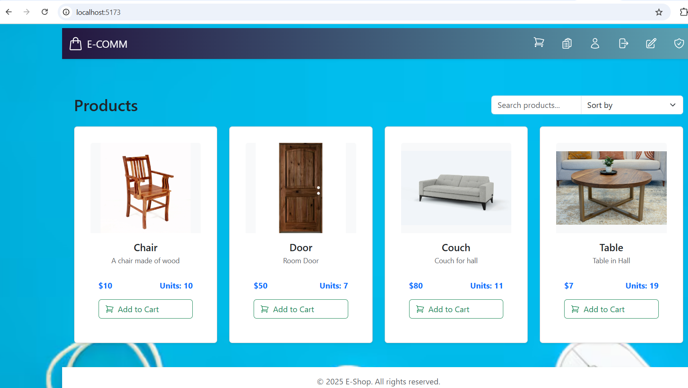
Home Page

Slide 3
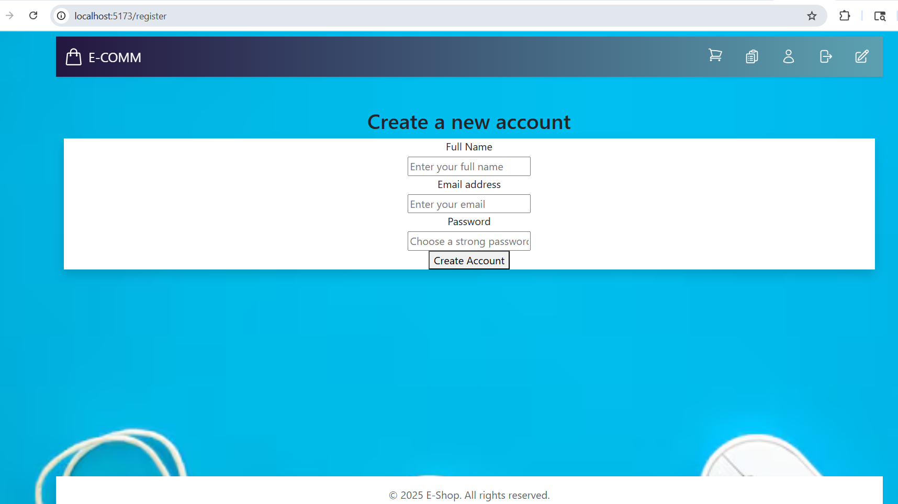
Account Creation

Slide 4
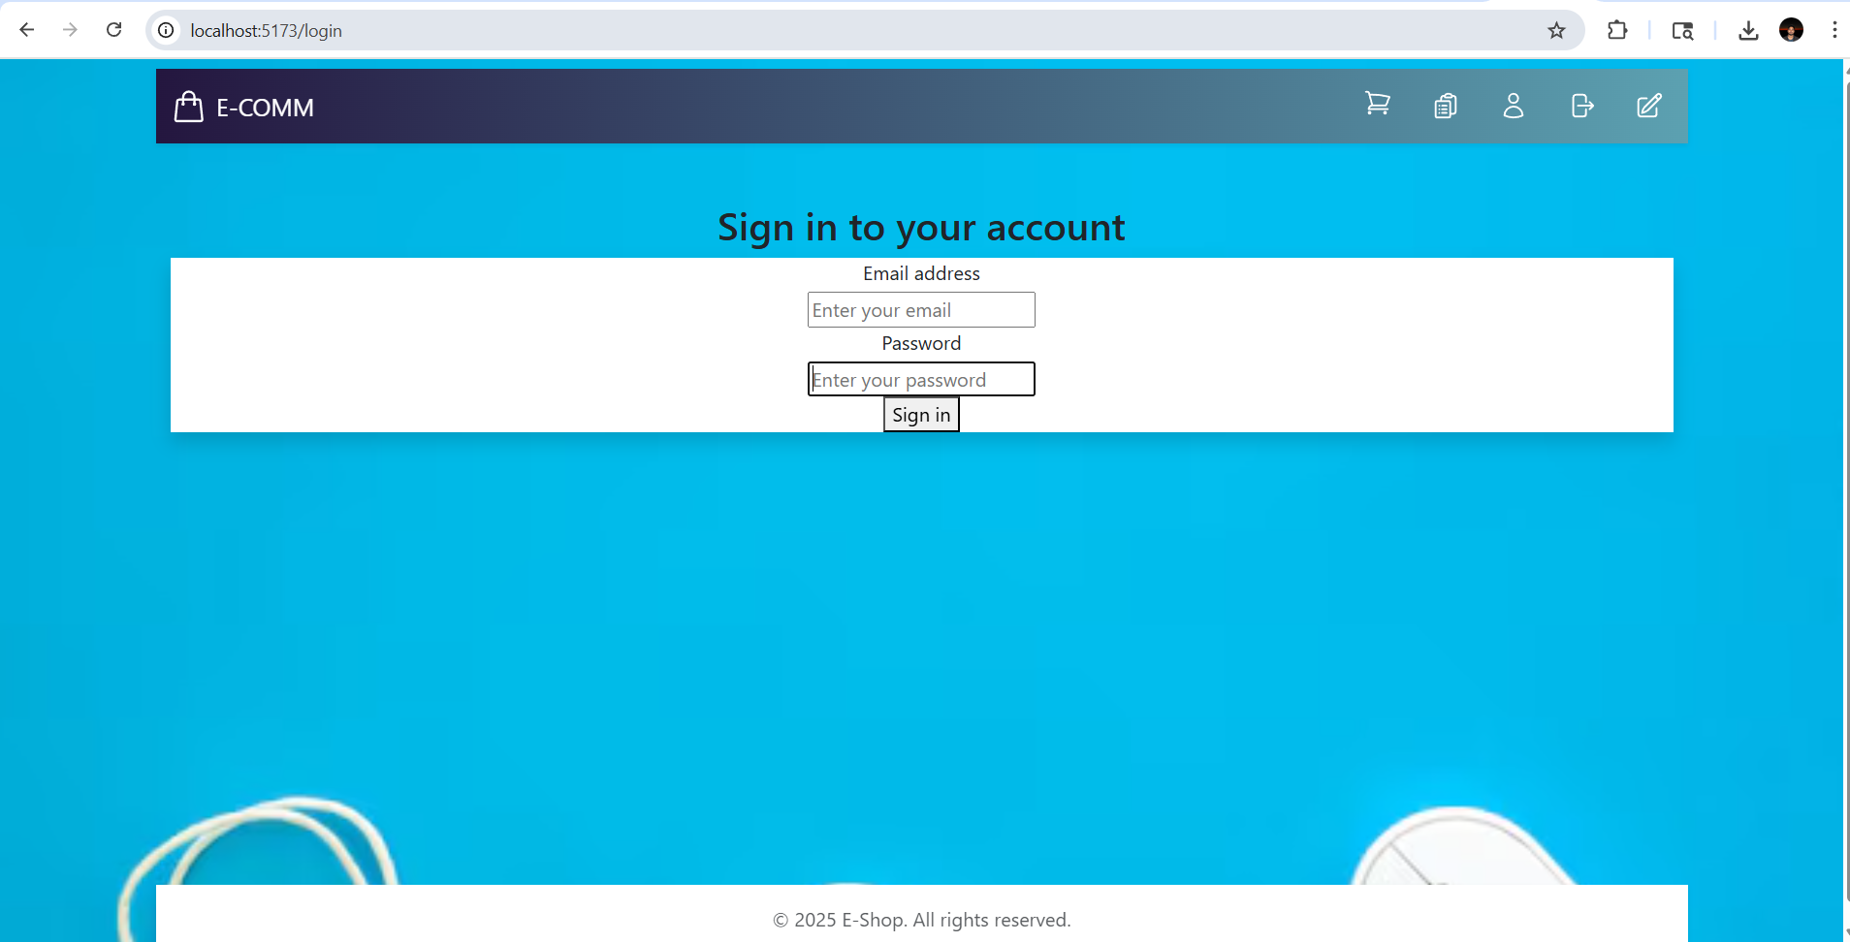
User Sign In

Slide 5
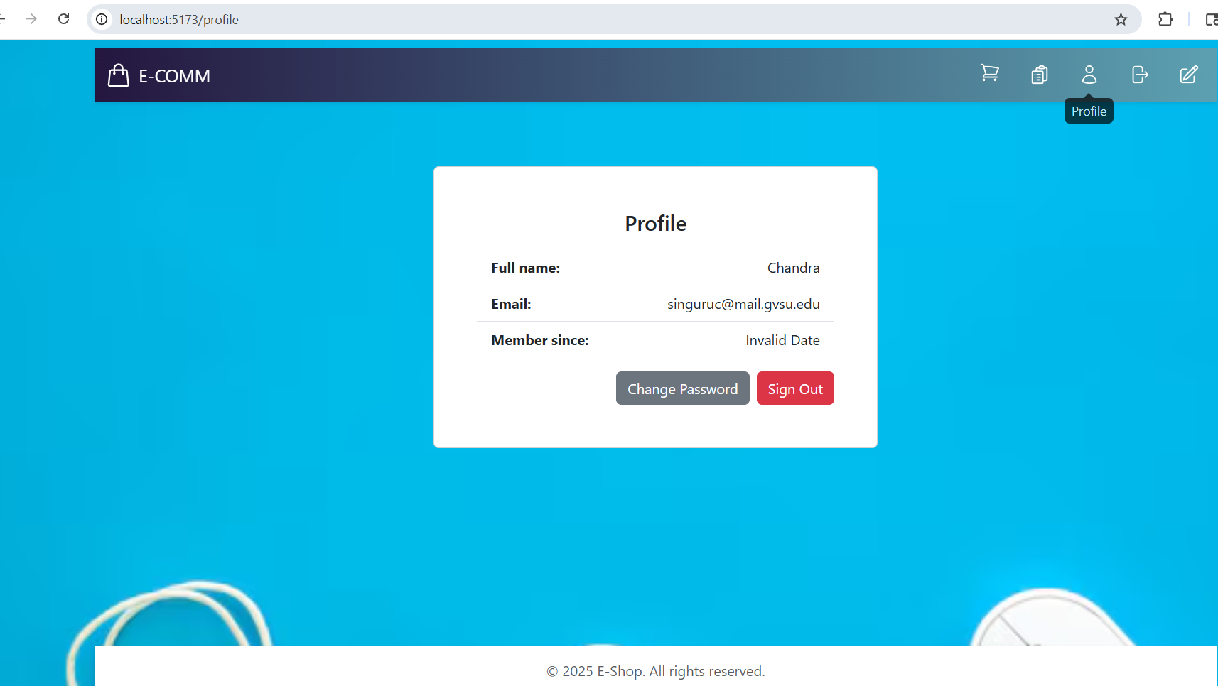
User profile

Slide 6
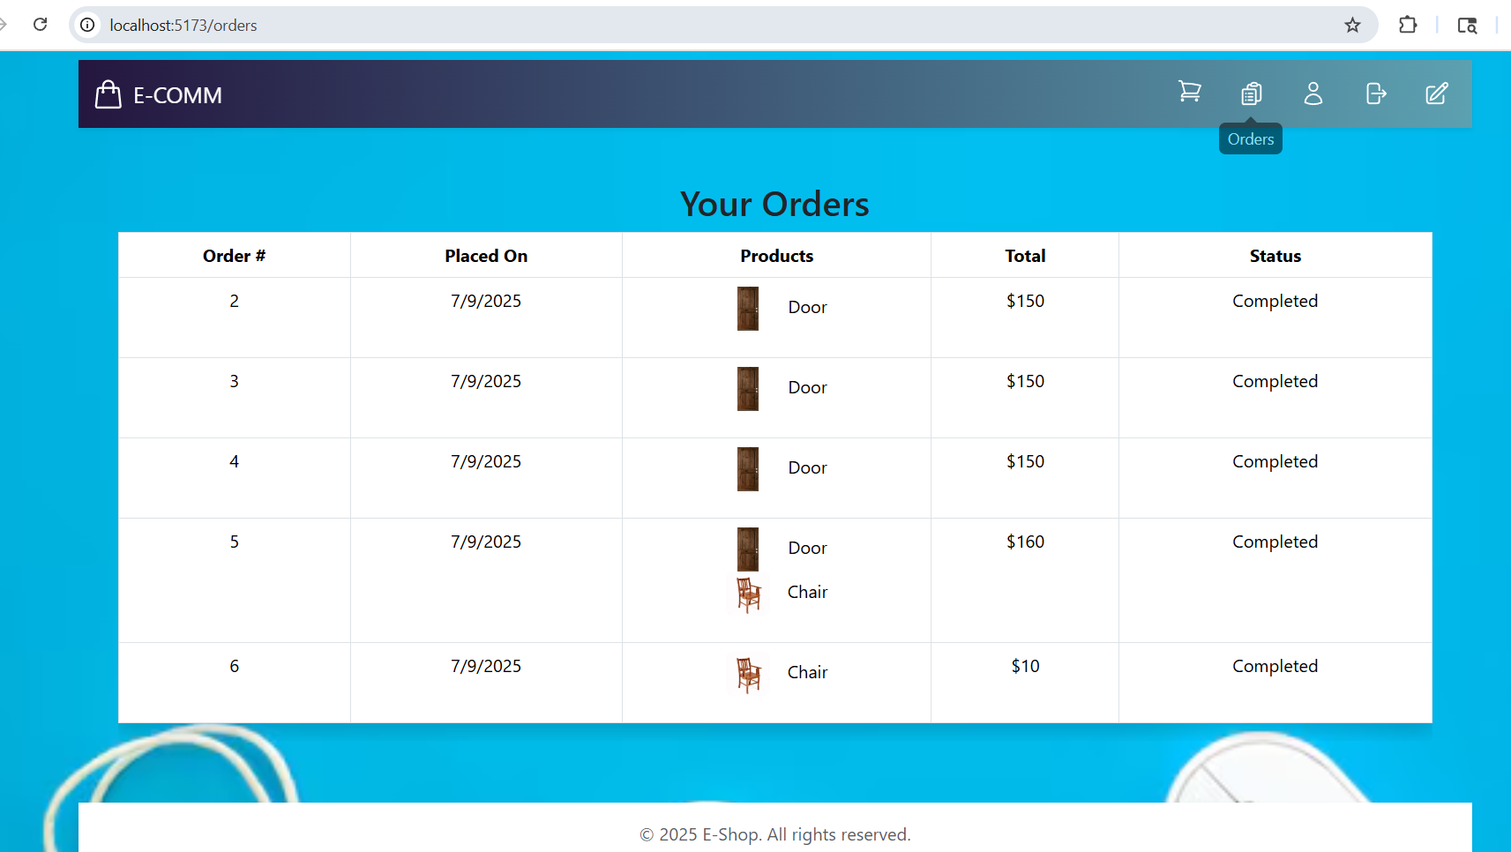
ORDERS HISTORY

Slide 7
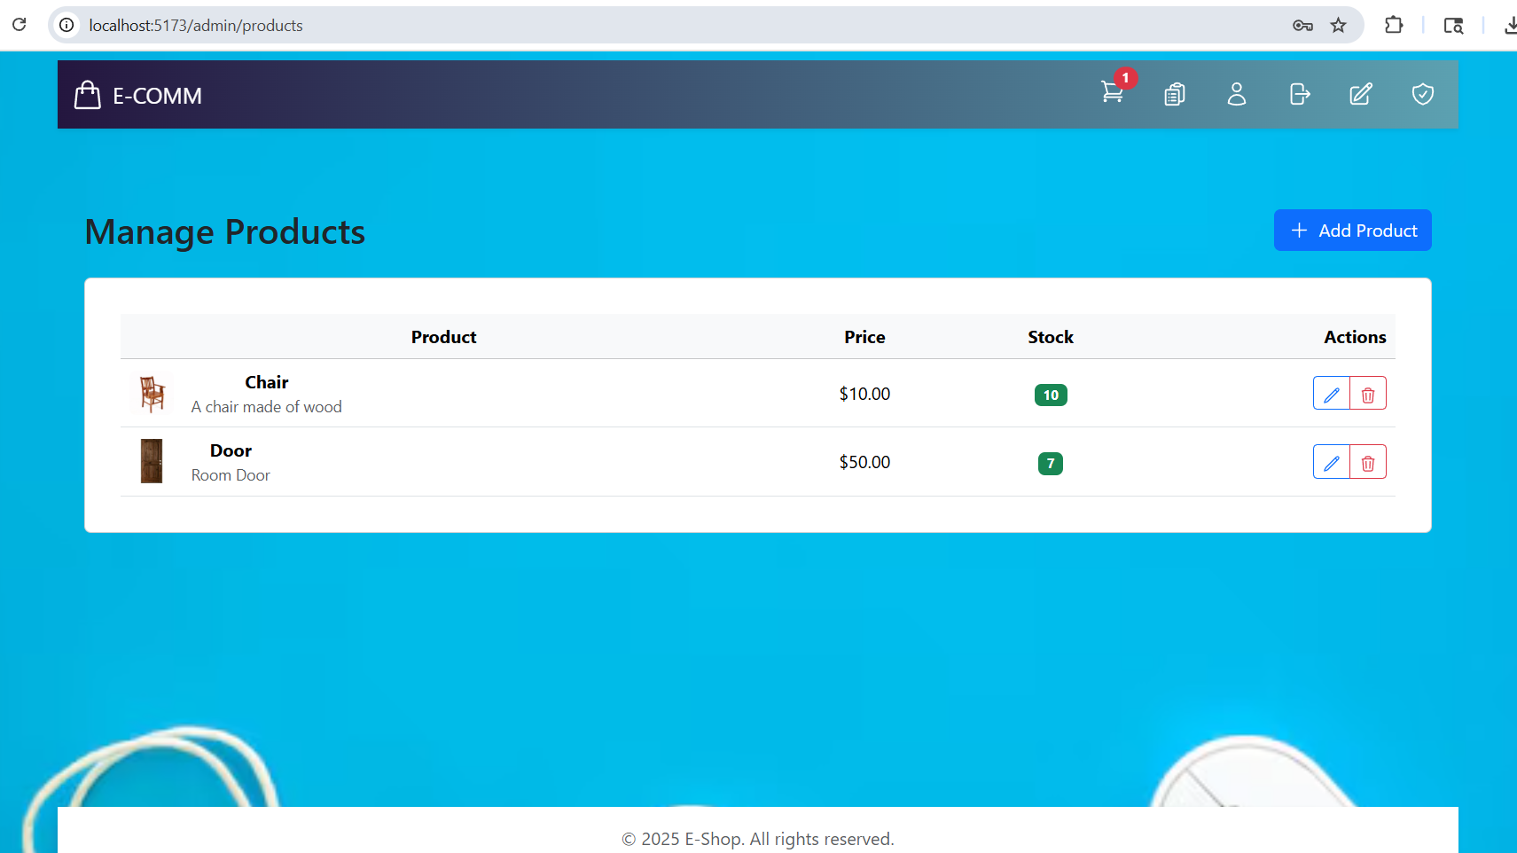
MANAGE PRODUCTS

Slide 8
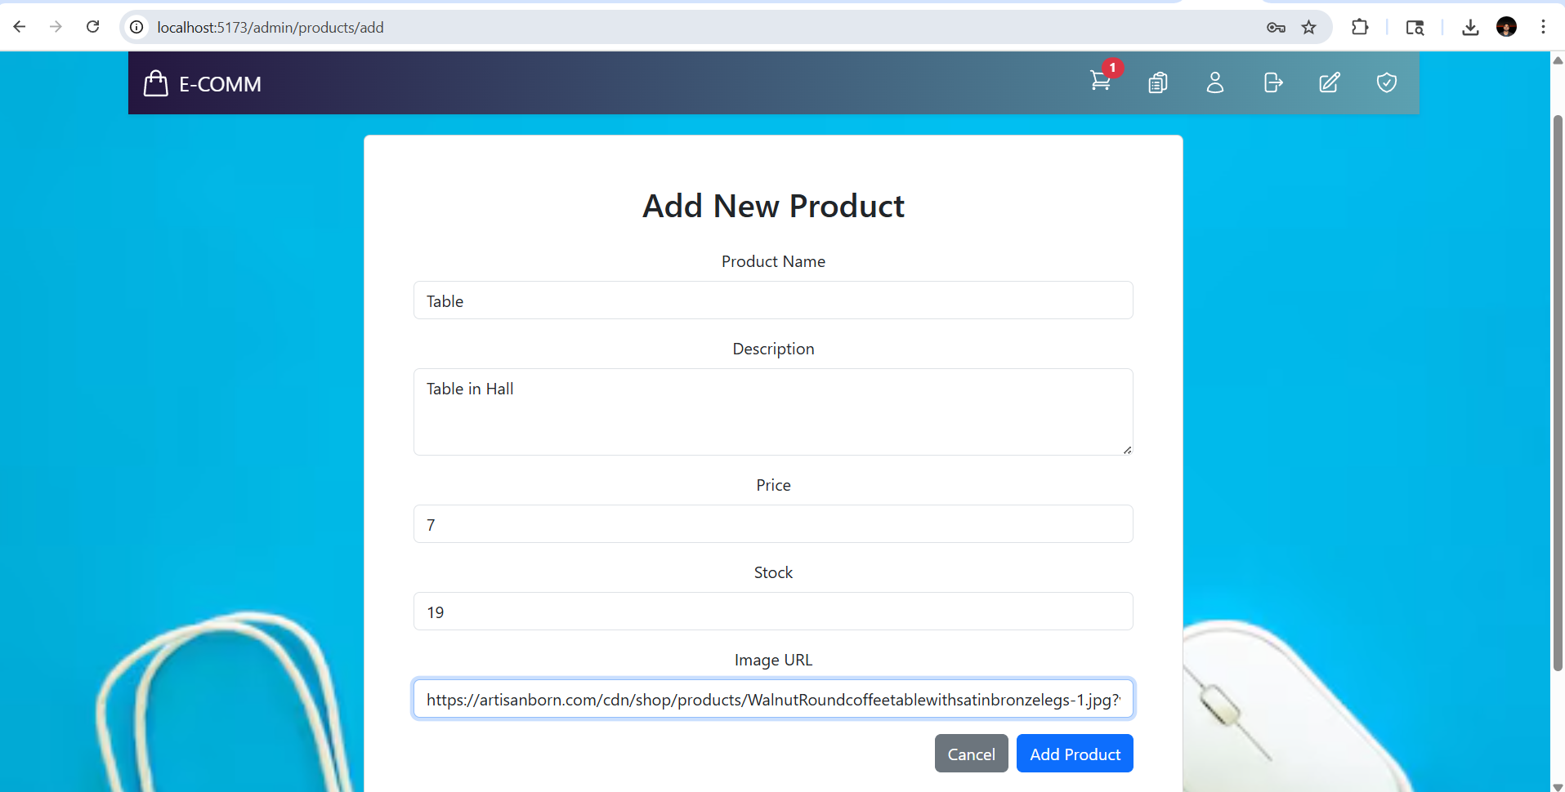
ADD New product

Slide 9
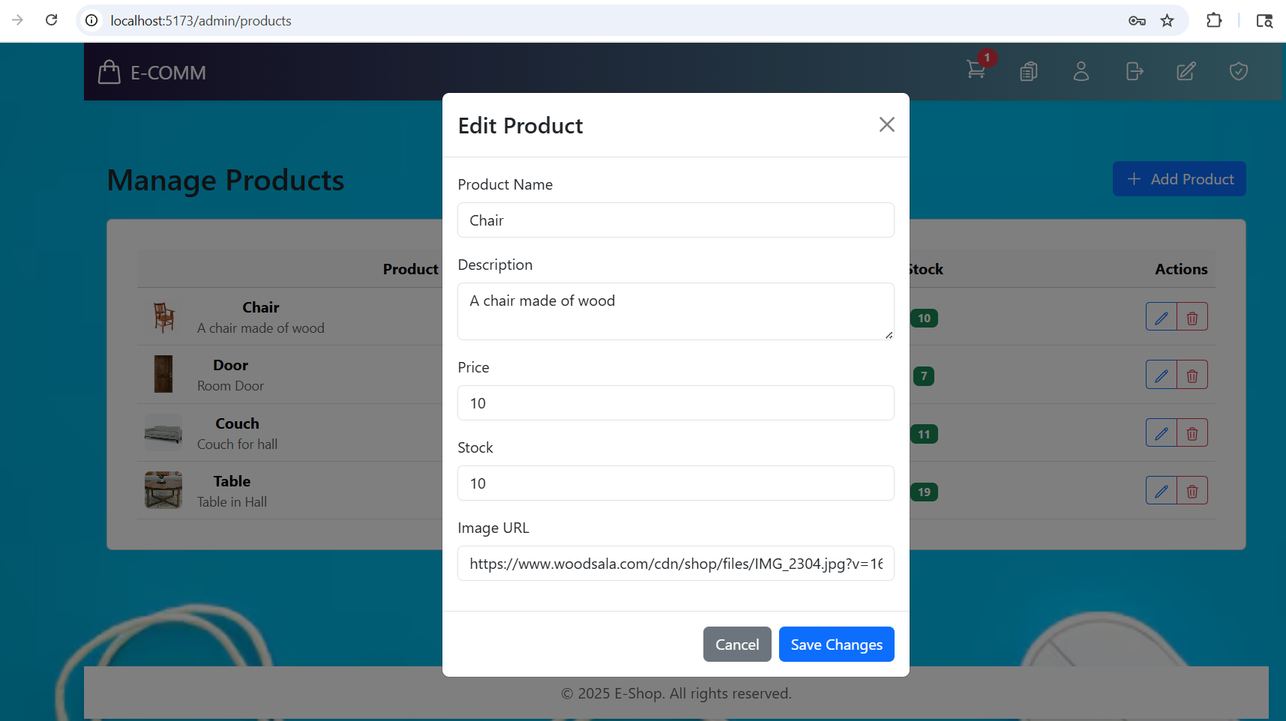
UPDATE PRODUCT

Slide 10
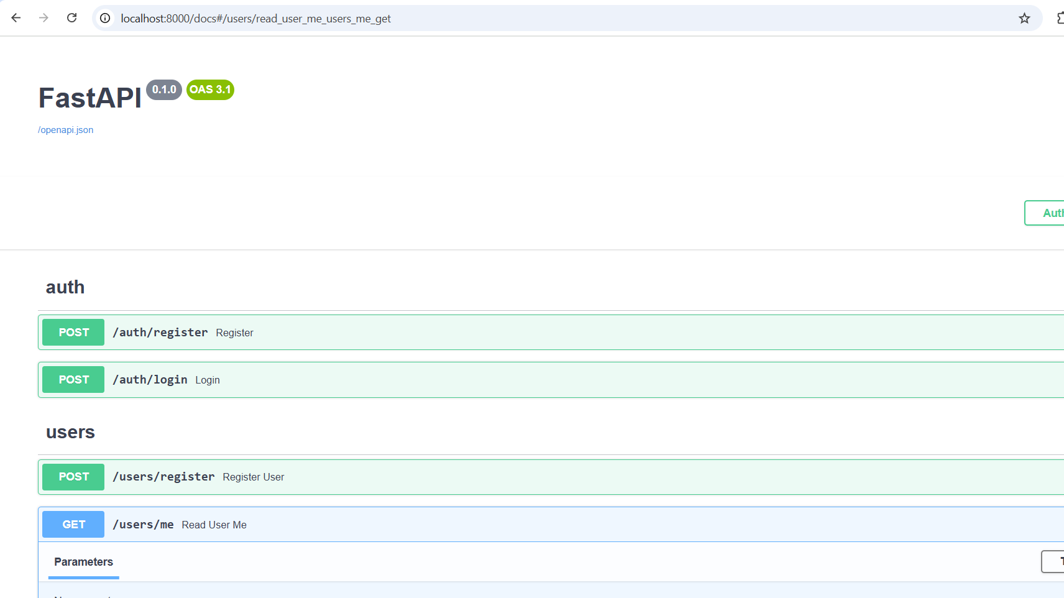
Fast api

Slide 11
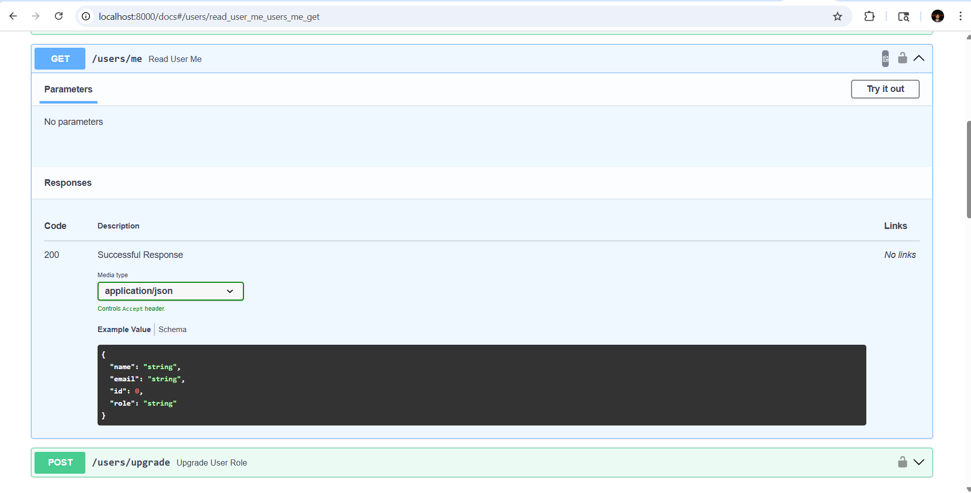
Before authorization

Slide 12
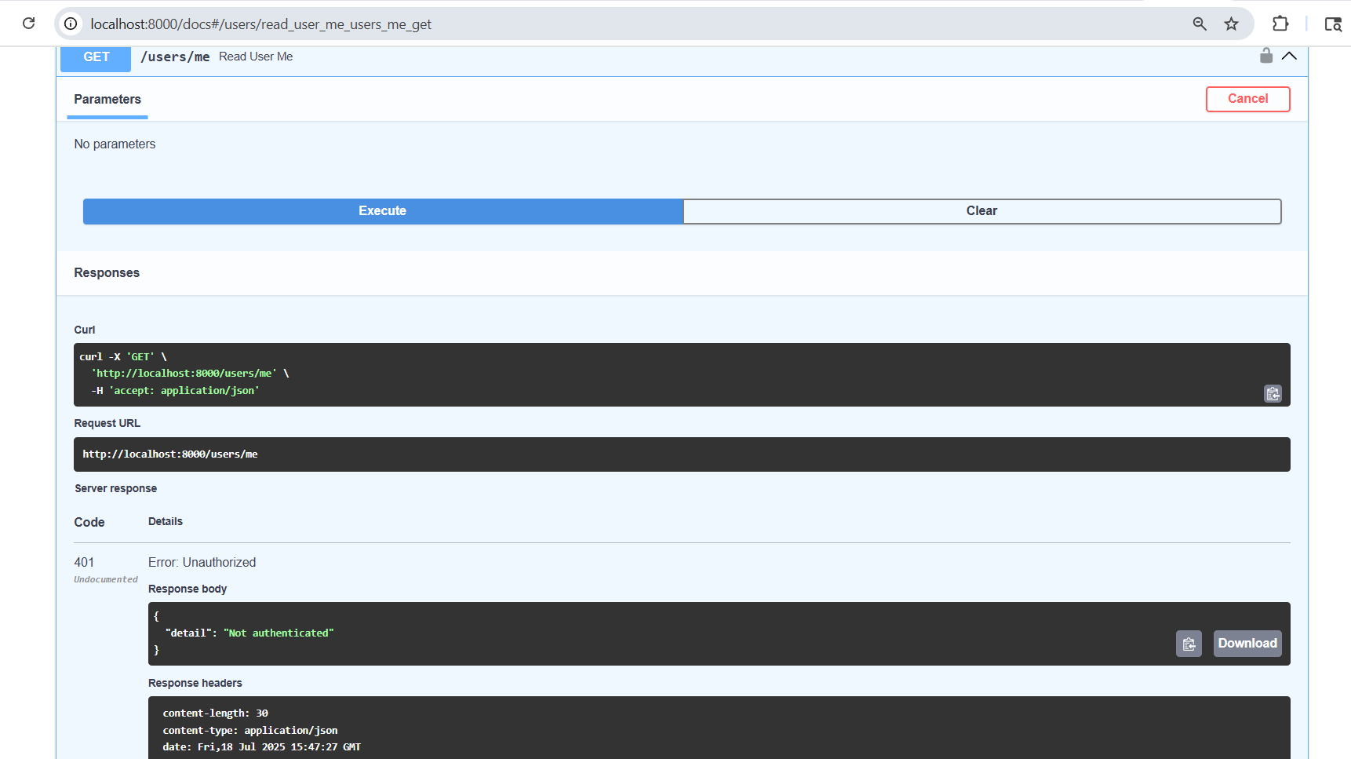
API Trying out

Slide 13
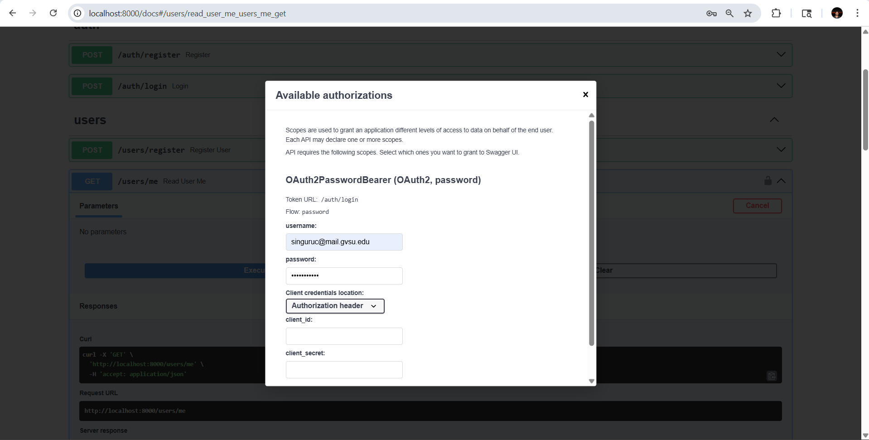
Authorization

Slide 14
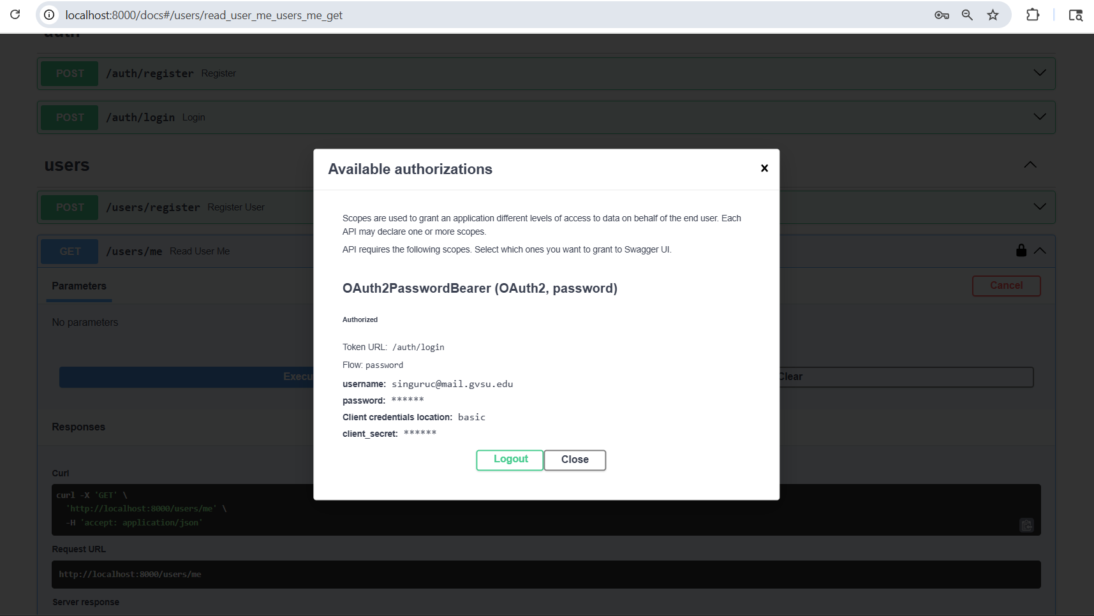
OAuth2PasswordBearer authorization

Slide 15
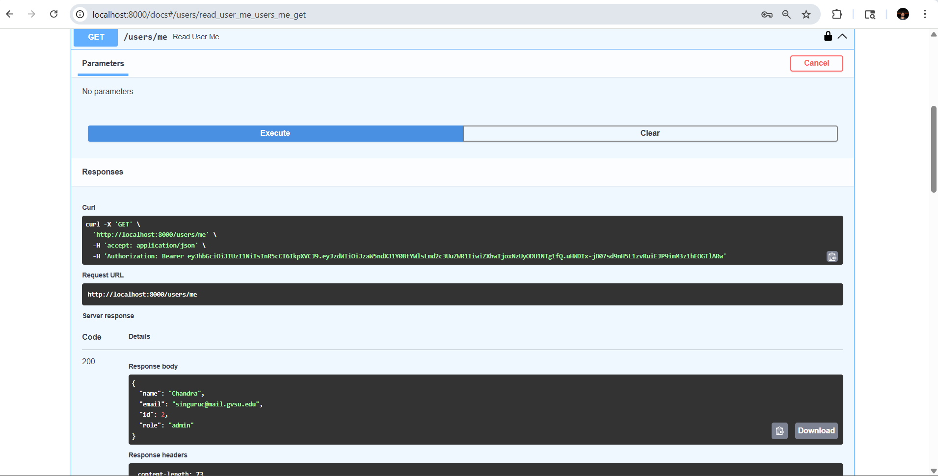
Response after executing

Slide 16


